Slide 1
GOES-19 L2 (Group 3) Provisional Validation
Peer/Stakeholder Product Validation Review (PS-PVR)
Feb. 12, 2025
NWS Perspective / AWIPS Verification
Derek Van Pelt / TOWR-S team
NWS Office of Observations

Slide 2
Overview
Land Surface Temperature
Full Disk
CONUS
MESO1, MESO2
(Land Surface Albedo, and Bidirectional Reflectance Factor are not represented in AWIPS)

Slide 3
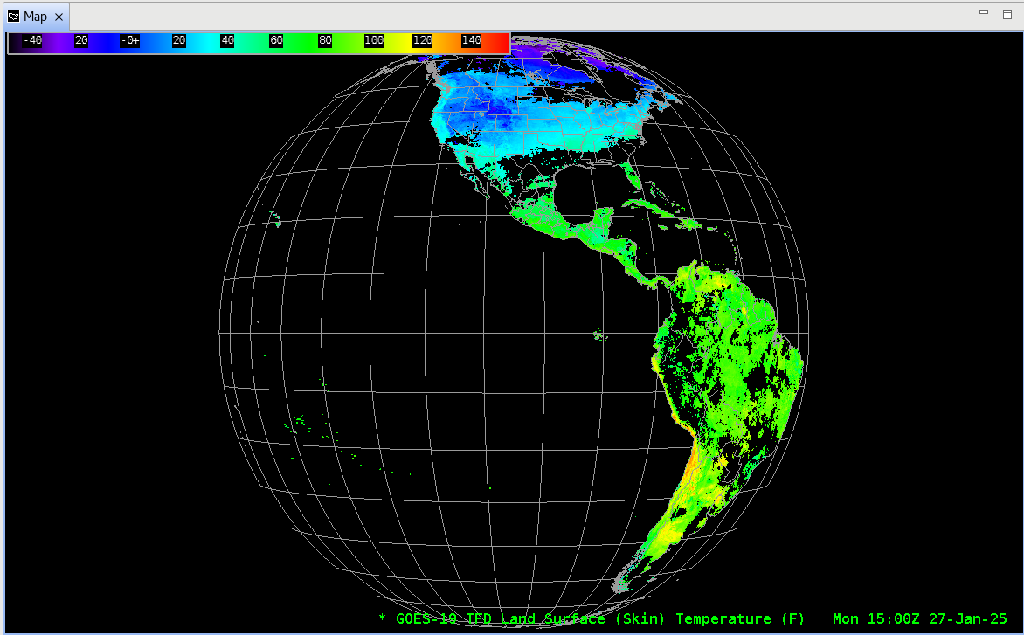
Land Surface Temperature
Full DISK

Slide 4
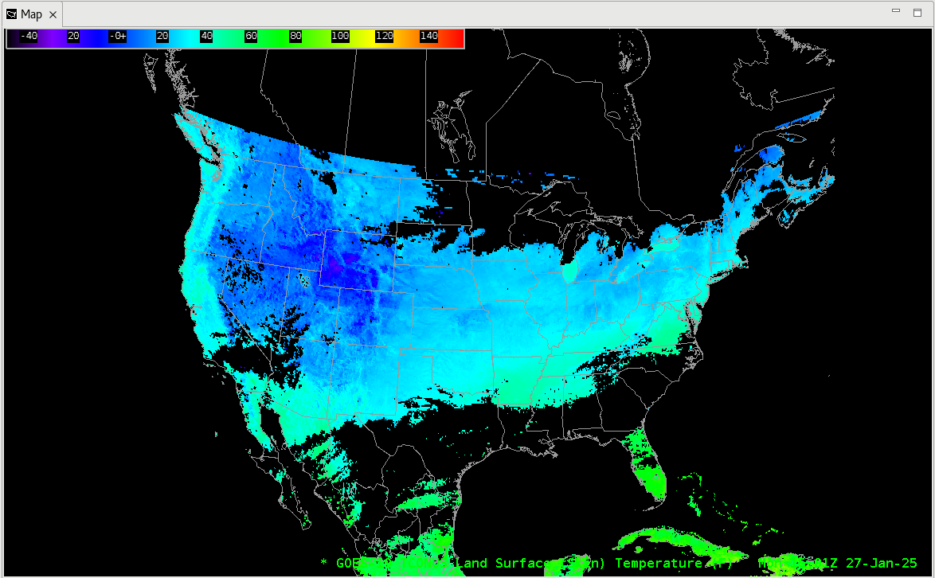
Land Surface Temperature
CONUS

Slide 5
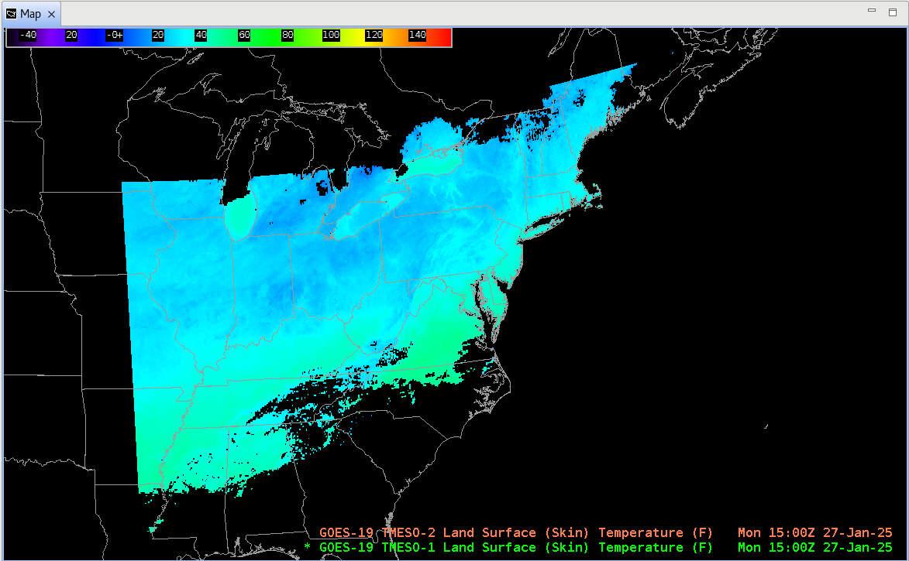
Land Surface Temperature
MESO 1, MESO 2

Slide 6
Notes
AWIPS ingests Land Surface Temperature using baseline GOES-16/17/18 configurations.
No fielding issues are expected
G-19 products conform closely to G-16,17,18 conventions (GOES-R Product User Guide)
AWIPS’ configurations for G16 and G18 are extensible for G19+

